Slide 1




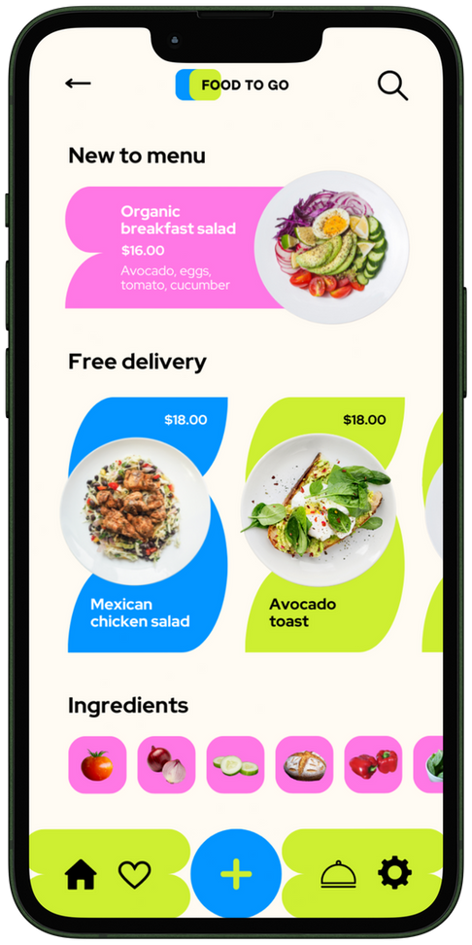







presented by
FOOD TO GO
Jai Akash R (6031BC98A6ED5F4A13142A8F3DC9E772)
Vignesh v.s (5E527C0742A34A2977B4DDF555DB27C4)
Gobikrishnan E (5EBB6E0887E384CB24B4D0AB97850BB2)
Srihari R (EFA5FF9EA7AA4C791084899610BD8E34
Narendran M(6E609400400A15BBD0841A7247B8EC5C

Slide 2

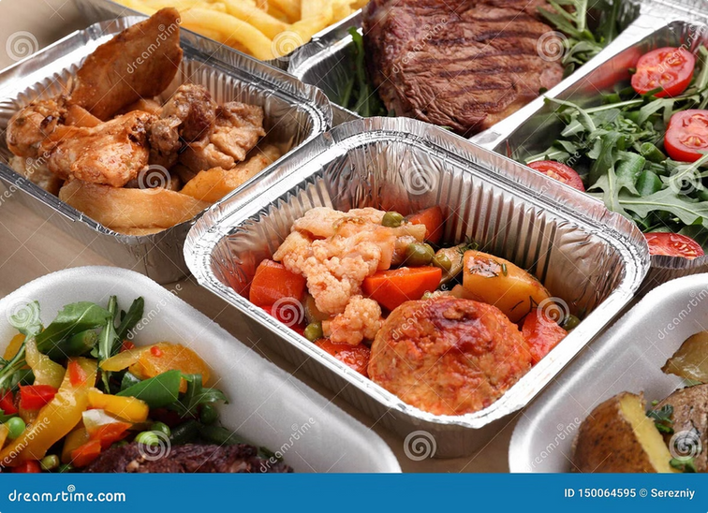

Introducing Snack Squad
Welcome to Snack Squad, your one-stop shop for all your snacking needs.
Notes:
1.7.2013
1
‹#›

Slide 3
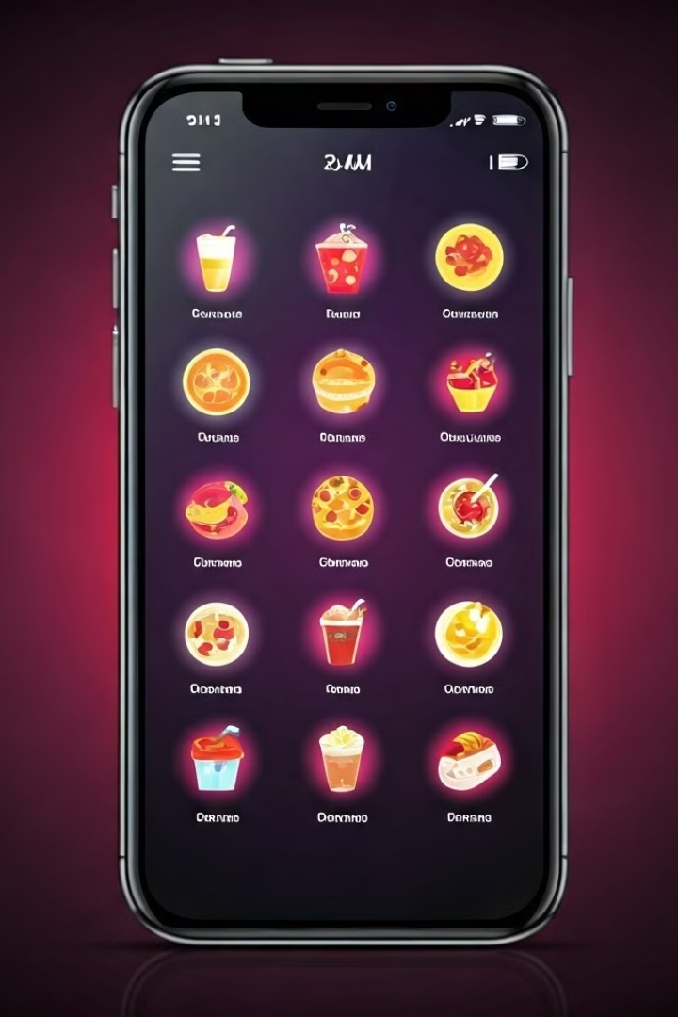
Convenience Meets Cravings
Our app makes ordering snacks effortless.
Browse Our Menu
Place Your Order
Discover a wide variety of snacks, from sweet treats to savory bites.
Choose your snacks, customize your order, and checkout with ease.
Track Your Delivery
Follow your order in real-time and get notified when it arrives.
Notes:
1.7.2013
2
‹#›

Slide 4




Diverse Menu, Endless Possibilities
We offer a wide range of snacks to satisfy any craving.
Pizza
Cookies
Popcorn
Fruit
From classic pepperoni to gourmet creations.
Soft and chewy, with a variety of flavors to choose from.
Perfect for movie nights or casual snacking.
Fresh and healthy snack options.
Notes:
1.7.2013
3
‹#›

Slide 5
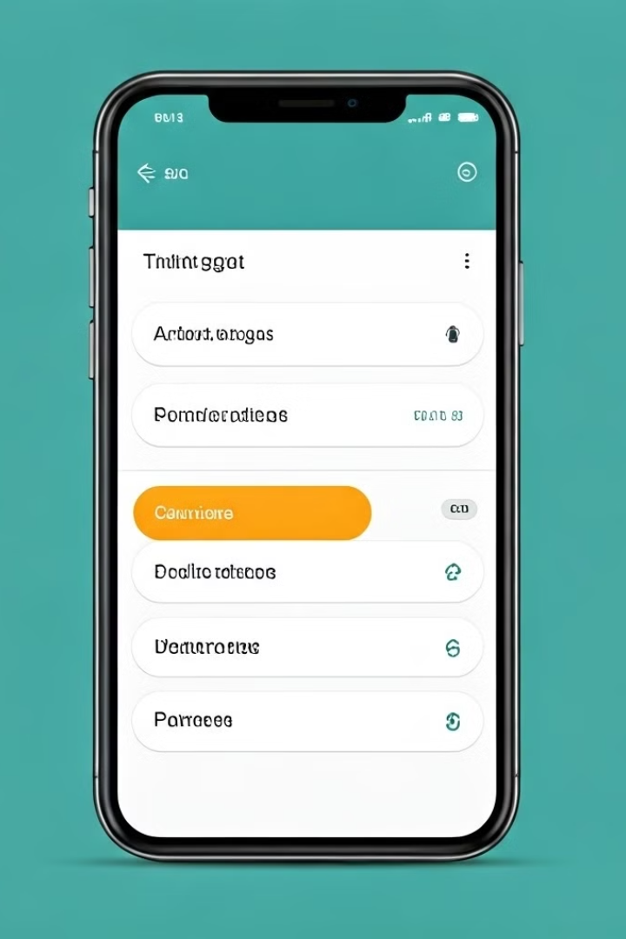
Streamlined Ordering Process
Ordering your favorite snacks has never been easier.
Browse
1
Explore our diverse menu and find your perfect snack.
Customize
2
Add toppings, modify sizes, and choose your desired options.
Checkout
3
Securely enter your payment information and confirm your order.
Track
4
Follow your order in real-time and receive delivery updates.
Notes:
1.7.2013
4
‹#›

Slide 6




Fast and Reliable Delivery
We prioritize speed and reliability for your convenience.
Order Placement
Submit your order through our app with a few clicks.
Order Processing
Our team efficiently prepares and packages your snacks.
Delivery Dispatch
Our drivers quickly deliver your snacks directly to your location.
Notes:
1.7.2013
5
‹#›

Slide 7

Rewards Program for Loyal Customers
Our rewards program is designed to show our appreciation for loyal customers.
Earn Points
Redeem Rewards
Exclusive Offers
1
2
3
Accumulate points for every order you place.
Use your accumulated points for discounts, free items, and exclusive deals.
Enjoy special offers and promotions reserved for our loyal customers.
Notes:
1.7.2013
6
‹#›

Slide 8


24/7 Customer Support
We're always here to help you with any questions or concerns.
Live Chat
Chat with a representative directly through our app.
Email Support
Send us an email and receive a prompt response.
Phone Support
Reach out to our customer service hotline for immediate assistance.
Notes:
1.7.2013
7
‹#›

Slide 9




The Future of Snack Delivery
Snack Squad is at the forefront of innovation in the snack delivery industry.
Cutting-edge Technology
We utilize advanced technologies to streamline our operations.
Sustainable Practices
We prioritize environmentally friendly solutions.
Continuous Improvement
We are committed to constantly enhancing our services.
Notes:
1.7.2013
8
‹#›

Slide 10



Snack Squad: Your Snack Delivery Solution
Welcome to Snack Squad, your one-stop shop for all your snack cravings. We deliver a wide selection of delicious snacks directly to your doorstep, making it easier than ever to satisfy your hunger pangs.

Slide 12

Delighting Customers with Variety and Convenience
We strive to offer a diverse range of snacks, catering to every taste and dietary preference. Our convenient ordering system makes it effortless to browse our selection, choose your favorites, and get your snacks delivered right to you.
1
Global Flavors
2
Dietary Options
Explore a variety of international snacks from around the world.
Find snacks that cater to your dietary needs, including vegan, gluten-free, and sugar-free options.
3
Personalized Recommendations
Our platform recommends snacks based on your past orders and preferences.

Slide 13
Sourcing the Best Snacks from Local Vendors
We believe in supporting local businesses and partnering with talented vendors who share our passion for quality snacks. By sourcing our products locally, we ensure freshness, support local economies, and minimize our environmental impact.
Local Bakeries
Specialty Snack Shops
Small-Batch Producers
Indulge in freshly baked treats from local bakeries, like cookies, pastries, and cakes.
Discover unique and artisanal snacks from local specialty shops, like gourmet chocolates and handcrafted crackers.
Support small-batch producers who create unique and delicious snacks, like artisan chips and hand-made popcorn.

Slide 14




Leveraging Technology for Seamless Ordering
We've built a user-friendly platform that makes ordering your favorite snacks as easy as possible. Our intuitive mobile app and website allow you to browse our selection, customize your order, and track your delivery in real-time.
Browse Our Selection
Customize Your Order
Track Your Delivery
Explore our wide variety of snacks categorized by type, flavor, and dietary preference.
Select your favorite snacks, adjust quantities, and add special instructions for delivery.
Follow your order in real-time, from the moment it's placed to its arrival at your doorstep.

Slide 15
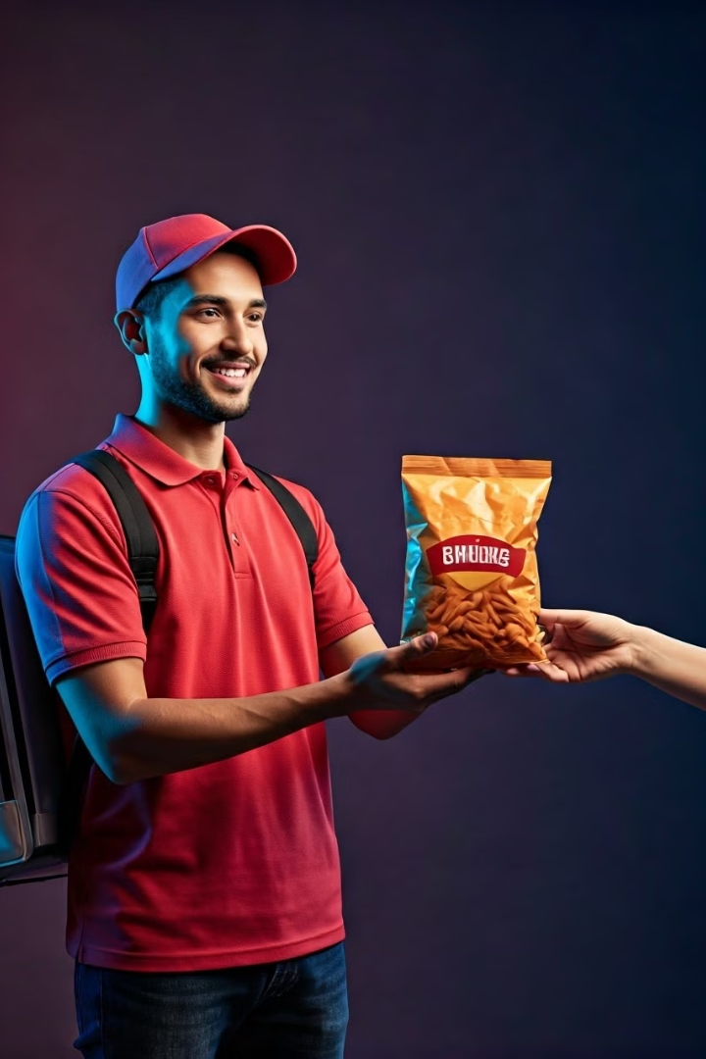



Optimizing the Delivery Experience
We're committed to providing a seamless and convenient delivery experience. Our efficient delivery network and dedicated team ensure your snacks arrive promptly and in perfect condition, every time.
Fast Delivery Times
Receive your snacks quickly and efficiently, with timely delivery windows.
Secure Packaging
Your snacks are carefully packaged to ensure they arrive fresh and intact.
Wide Delivery Area
We offer delivery to a wide range of locations, covering your snacking needs.

Slide 16

Building a Community of Snack Enthusiasts
We want to create a community of snack enthusiasts who share our love for delicious treats. Our platform offers opportunities for customers to interact, share their favorite snacks, and discover new culinary delights.
Snack Reviews
Share your thoughts and ratings on your favorite snacks.
Social Media Integration
Connect with other snack lovers and follow our social media channels for exclusive offers.
Community Forums
Join online discussions and share your snacking experiences with others.

Slide 17
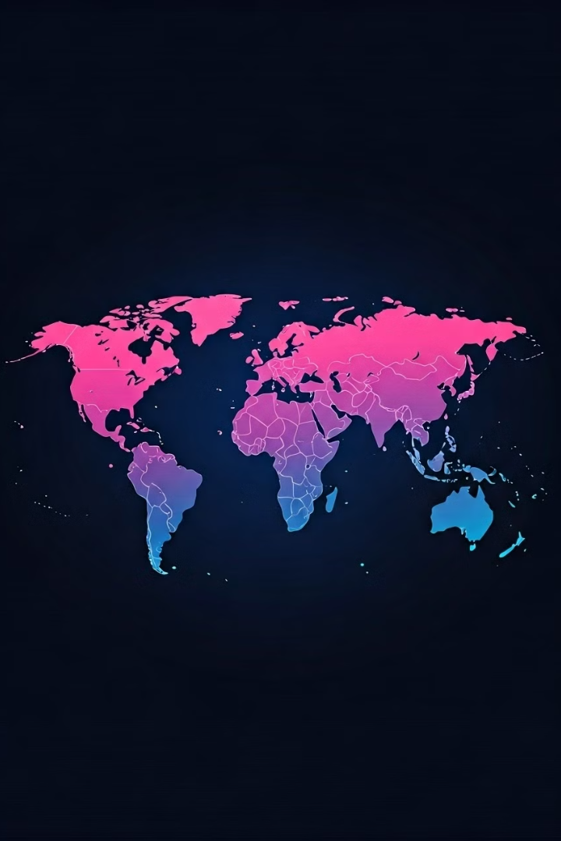
The Future of Snack Delivery: Expanding Our Reach
We're always looking for new ways to expand our reach and offer our services to a wider audience. We're exploring partnerships with new vendors, expanding our delivery area, and developing innovative features to enhance the Snack Squad experience.
1
New Vendor Partnerships
Collaborate with new local vendors to offer an even wider selection of snacks.
2
Expanded Delivery Area
Reach more customers by expanding our delivery services to new neighborhoods and cities.
3
Innovative Features
Introduce new features like subscription services and personalized snack recommendations.

Slide 18

Snack Squad: Making Snacking Easier
Snack Squad makes it easier than ever to indulge in your favorite snacks, without the hassle of leaving your home or office. We're here to make snacking more convenient, delicious, and enjoyable for everyone.
Convenience
Variety
Get your favorite snacks delivered right to your doorstep, hassle-free.
Explore a wide range of snacks to suit every taste and preference.
Quality
We source our snacks from trusted local vendors, ensuring freshness and quality.

Slide 19
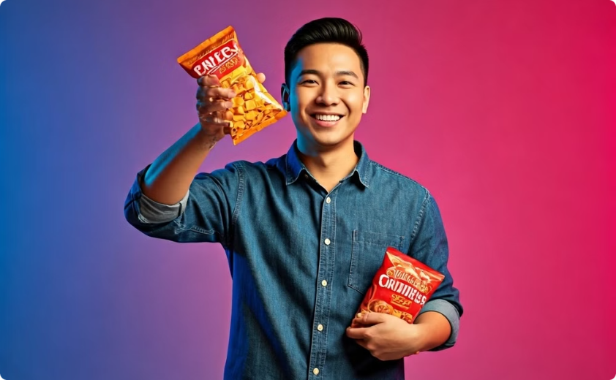

Our Commitment to Customer Satisfaction
We're committed to providing exceptional customer service and ensuring your satisfaction. Our team is always available to assist you with any questions or concerns you may have.
Happy Customers
Excellent Support
We strive to make every customer happy with our service and snacks.
Our customer service team is always available to answer questions and assist with orders.

Slide 20

Join the Snack Squad Community
Join our growing community of snack enthusiasts and experience the joy of delicious treats delivered right to your doorstep. We're excited to share our love for snacks with you!
1
Download Our App
2
Follow Us on Social Media
Download the Snack Squad app today and start browsing our selection of snacks.
Stay up-to-date on our latest offers, news, and snacking inspiration.
3
Share Your Feedback
Let us know what you think! Share your thoughts and reviews to help us improve.

Slide 21
THANK YOU

